Slide 1
Paleoclimate Reconstruction and Forecasting
Seeking to understand, visualize, and predict long-term climate patterns, particularly ice ages, with neural networks, genetic algorithms, and classical statistical methods
Viktor Butkovich - May. 7, 2025

Slide 2
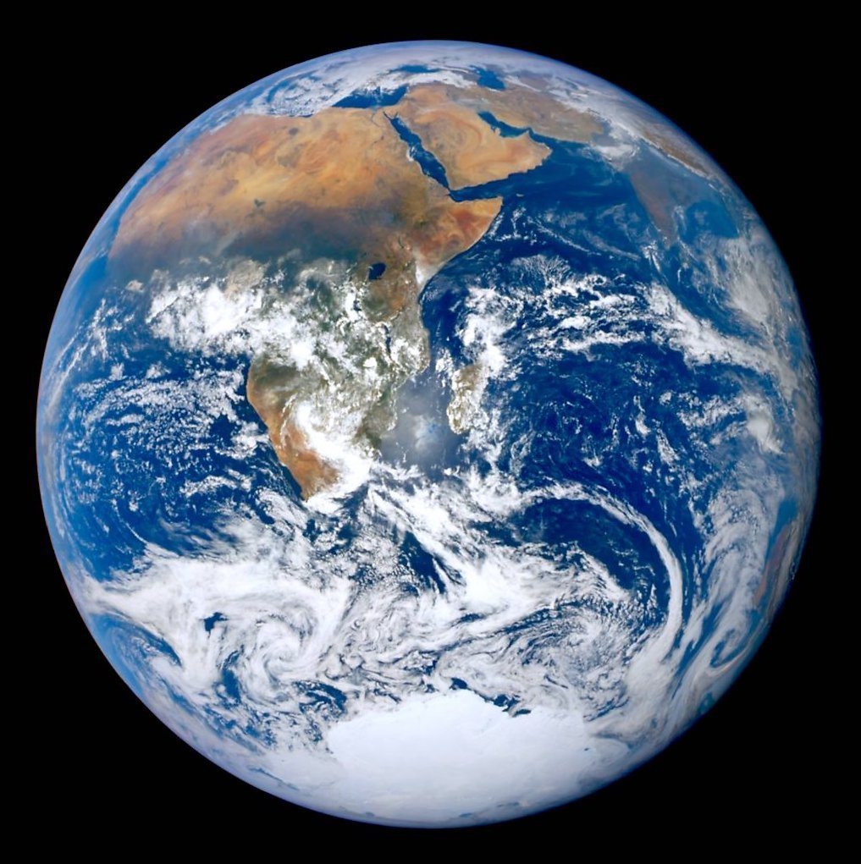
Objective
Understanding the Earth-climate system:
Like a function with unknown behavior:
Earth(CO2, orbit, solar modulation, … ?) = Climate
Earth(422 ppm CO2, current orbit, solar modulation…) = +1.4 °C above average
Earth(Optimal Conditions at 2100) = ?
Earth(Expected Conditions at 2100) = ?

Slide 3
Objective
Understanding the Earth-climate system:
Earth’s past climate cycles – glaciation (ice ages):
Earth(Parameters at 500k BC) = Climate at 500k BC
Earth(Parameters at 400k BC) = Climate at 400k BC
Understanding of past climate can be measured by prediction performance:
Predict climate at 300k BC and compare to known values
Not perfect, but thoroughly understanding Earth’s past behavior could help predict the effects of future, unprecedented conditions

Slide 4
Data Preparation
How do we know Earth’s past climate?
Climate proxies: Measurements used to reconstruct past climate
Ice cores: Concentrations of gases of air trapped in ice caps
Fossil pollen/tree rings: Indication of vegetation growth by year
Beryllium-10: Isotope produced by interactions between cosmic rays and magnetic field – concentration is a function of solar modulation and magnetic field strength
Solar modulation: Extent to which sun blocks cosmic rays – unblocked cosmic rays cause more cloud cover, decreasing temperatures, influencing whether glaciers melt or expand each year
Beryllium-10 concentrations and magnetic field proxies can be combined to calculate solar modulation factor
Numerous climate proxy datasets located in NOAA Paleoclimatology Data Search

Slide 5
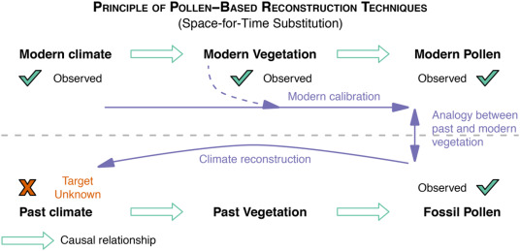
Data Preparation
How do we know Earth’s past climate?

Slide 6
Data Preparation
How do we know Earth’s past climate?
Simulation Models: Earth’s orbit is known to follow predictable patterns that can be reliably simulated into the past and future
Milankovitch cycles: Orbital fluctuations (eccentricity, obliquity, perihelion, insolation) found to follow some pattern as glacial cycles
Milankovitch Orbital Data Viewer

Slide 7
So Many Datasets!
Temp12k Dataset (Not just the last 12k years)
Dated temperature proxy samples from all over the world for the last 1 MYA (million years ago)
Data Overview - Berkeley Earth
Estimated temperatures and long-term climate average for each latitude/longitude for most months since 1850
kjg136/MLdipolePredictions
Elusive 2 MYA magnetic field data buried in a .mat file in a research paper’s GitHub
Milankovitch Orbital Data Viewer
Milankovitch cycle simulator, produces orbital parameters for 1 MYA to 1 million years in the future
Several CO2 datasets for modern and distant past CO2 concentrations
Several Beryllium-10 concentration datasets – very difficult to find at a high resolution
How to integrate these into a single repository for analysis?

Slide 8
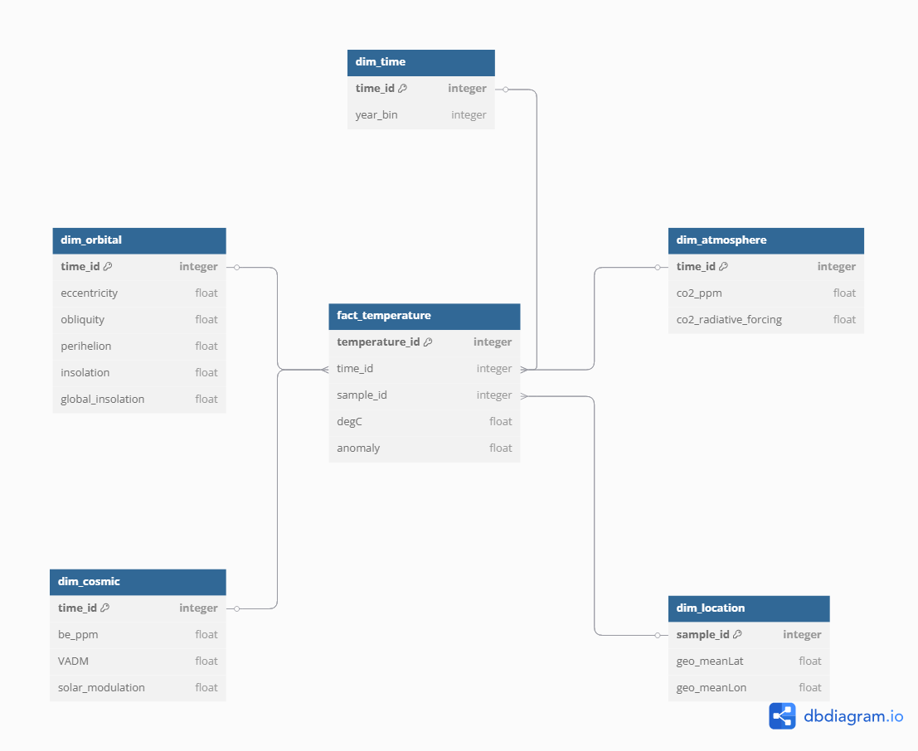
Data Warehouse
Data Warehouse: Sub-type of database optimized for analytical queries and integrating batch data from various sources, (as opposed to a transactional database optimized for frequent insertions/deletions from a single application)
Follows a star schema, a database architecture for simple analysis of a central fact table containing core measurements, like estimated temperature from a dated sample at a particular location
Fact table can be joined with dimension tables to analyze with context of CO2, location, year, etc.

Slide 9
Data Warehouse
ETL: Process that Extracts, Transforms, and Loads data –
Extract: Load data from various .csv, .pkl, .mat, .nc, etc. files in their respective original formats
Transform: Preprocess data with common units, extrapolate missing values, join related data, split into star schema structure
Load: Upload combined dataset into a single data warehouse. We can then freely query this to build view datasets for analysis:
E.g. get a view with the global average climate anomaly, orbital parameters, and CO2 concentration for each year before 1750

Slide 10
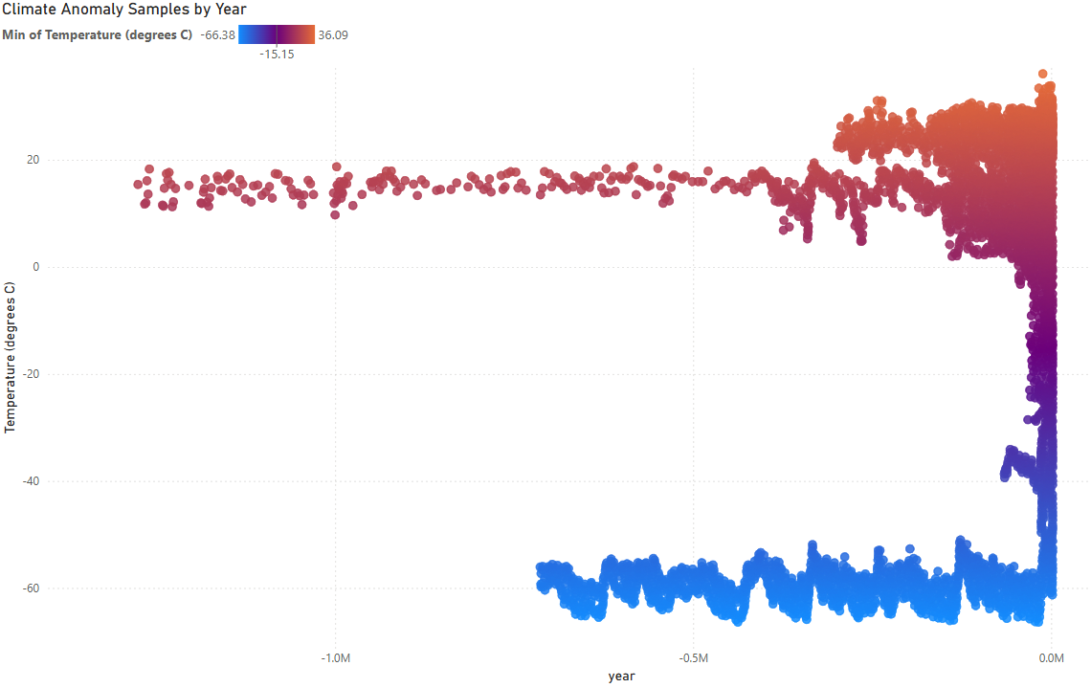
Exploratory Data Analysis
We finally have a dataset!
Looking at temperature samples each year isn’t very helpful

Slide 11



Exploratory Data Analysis
More recent temperature samples are abundant
We finally have a dataset!
Looking at temperature samples each year isn’t very helpful
Low resolution data for more distant years
Antarctic ice core samples

Slide 12
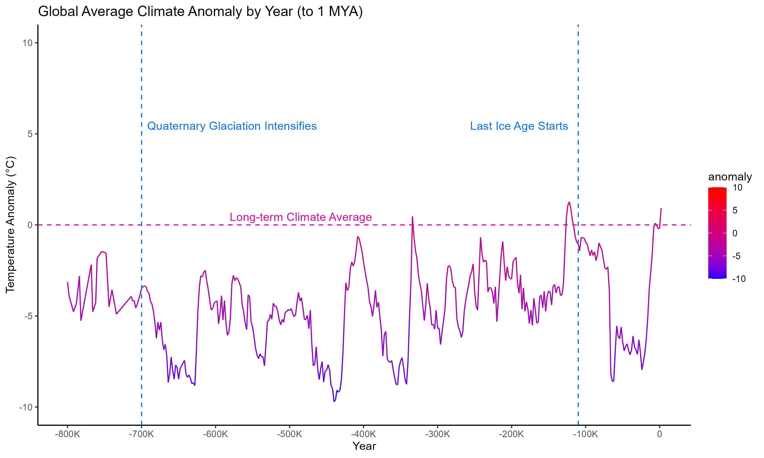
Exploratory Data Analysis
Instead, we can focus on analyzing average climate anomaly: deviation of a sample from the long-term average temperature of the area

Slide 13
Exploratory Data Analysis
Instead, we can focus on analyzing average climate anomaly: deviation of a sample from the long-term average temperature of the area
: Ice ages

Slide 14
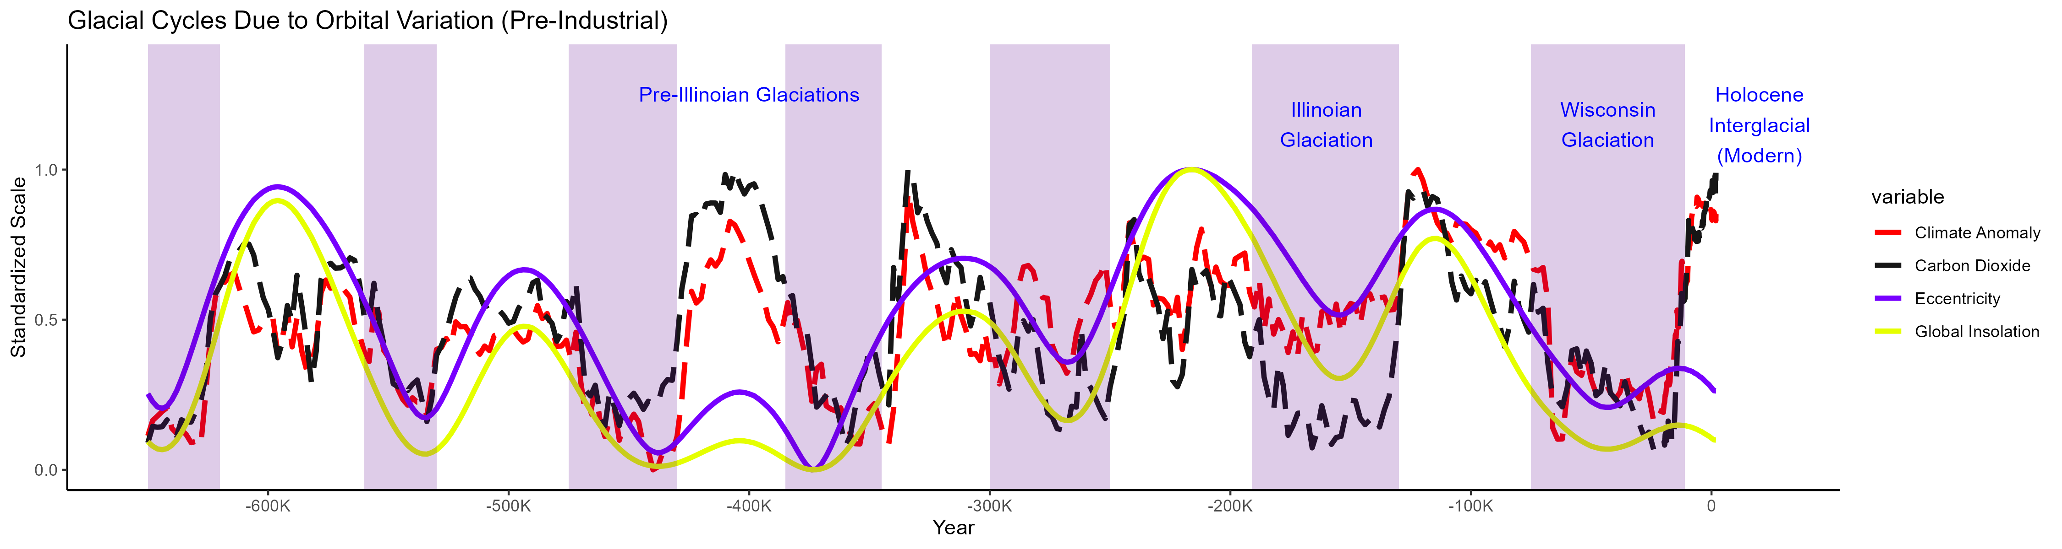
Exploratory Data Analysis
Fluctuations in orbital parameters like eccentricity and global insolation are associated with the start and end of all recent ice ages – these seem to somehow be driving the values of CO2 and climate anomaly
(Causation – conditions on Earth’s surface are unlikely to affect orbital parameters, so the orbital parameters are either driving Earth’s glacial cycles or highly coincidental)
: Ice ages

Slide 15
Methods
We can predict climate anomaly through regression: Approximating a formula for a continuous DV (dependent variable) from a variety of IV’s (independent variables)
Linear regression: Simplest form of regression, assumes a change in a DV results in a linear change in the IV
y = m1 * x1 + m1 * x2 + m3… + b
Climate anomaly = CO2 * 0.03 – eccentricity * 0.8 + … 0.2
Many more complex forms of regression exist
Neural network: Bio-inspired method where input IV’s are passed through many layers of “neurons”, which have importance weights for each input variable used to determine the signal sent an input to the next layer of neuron
A neural network can perform regression by using the output of the final layer, which only has 1 neuron, as the predicted value of the DV
Based on the prediction’s accuracy, the weights can be adjusted so that the next prediction I closer

Slide 16
Feature selection
An important aspect of regression is the selection of which features, or IV’s, to use:
Multicollinearity: If multiple IV’s are too highly correlated with each other, it can be counter-productive to include all of them
Availability:
A feature is more effective for forecasting if we know its future values, so that they are available when making the forecast
A feature is more effective if it has accurate, high-resolution values
Relevance: Each feature should somehow be correlated with the DV

Slide 17
Feature selection
Orbital parameters: Can reliably be simulated into the past and future with whatever resolution we need, found to be associated with glacial cycles
Solar modulation: Theorized to be the root cause of the start/end of glacial cycles, but must be derived from beryllium-10 and magnetic field proxy measurements, which are low-resolution and difficult to predict into the future
Lagged climate anomaly: Lagged climate anomaly, such as the anomaly 100k years before, are available for future predictions and highly correlated with future anomaly values

Slide 18
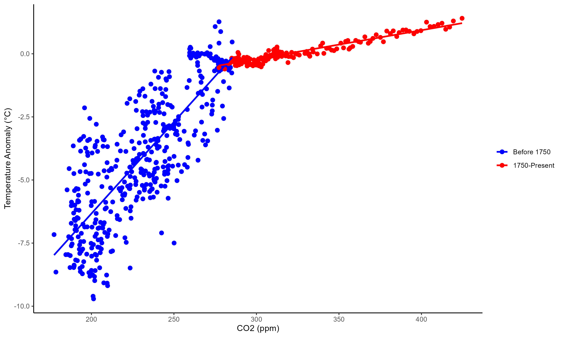
Feature selection
CO2: Very highly correlated with climate anomaly, but its future values are unpredictable, and modern conditions do not match the historical correlation between CO2 and climate anomaly
CO2’s modern (and likely future) relationship is different than before industrialization – each increase in CO2 is now associated with less of a temperature increase than before, so predictions based on this past relationship may now be inaccurate.

Slide 19
Data Split
Train/validate/test:
Train: Portion of the data designated for training models – each iteration attempts to improve training prediction performance
Validation: Portion of the data used to evaluate the effectiveness of training on data it hasn’t seen before – if validation performance is decreasing, the training is no longer helping for our predictions
Mean squared error (average square of deviation from actual value) is used as our main model performance metric
K-fold Cross-validation: By training K different models (e.g. 5) that each use different portions of the data as train/validation and aggregate their predictions, we improve performance by ensuring all non-test data is used for both training and validation
Test: Portion of the data used to estimate the margin of error
As long as test data is never used for performance evaluation, it will remain a minimally biased estimate of the error of our forecast on data we have not yet encountered

Slide 20
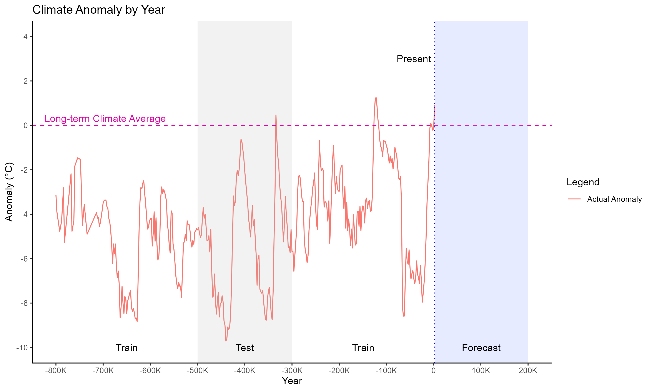
Data Split

Slide 21
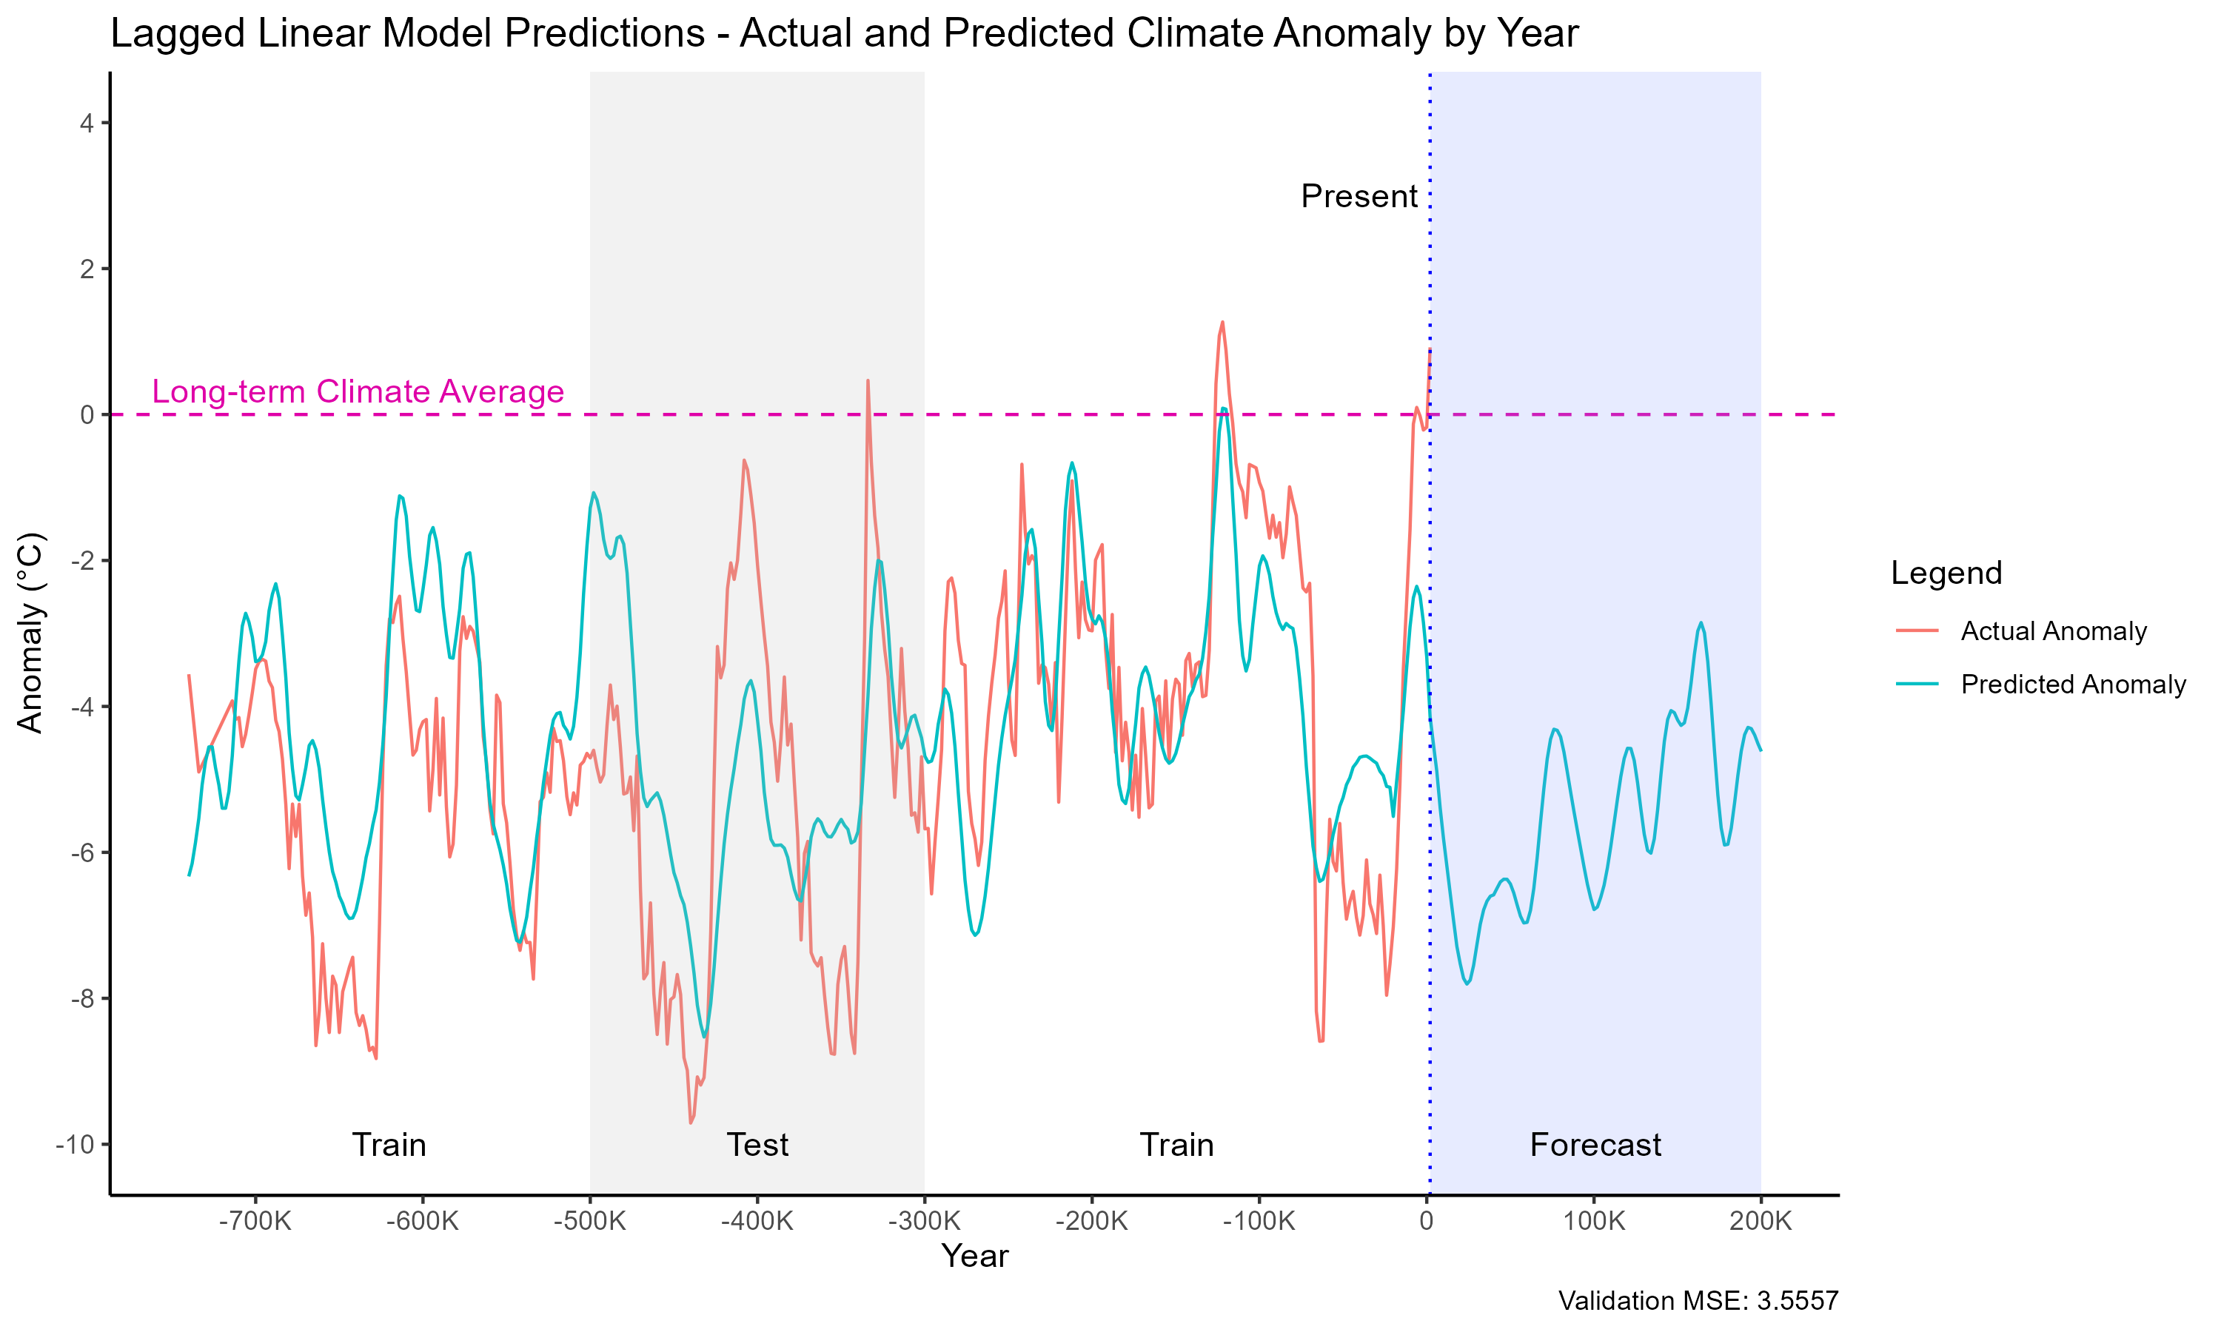
Results
Our simplest model, linear regression, has reasonable performance, with an MSE of 3.56

Slide 22
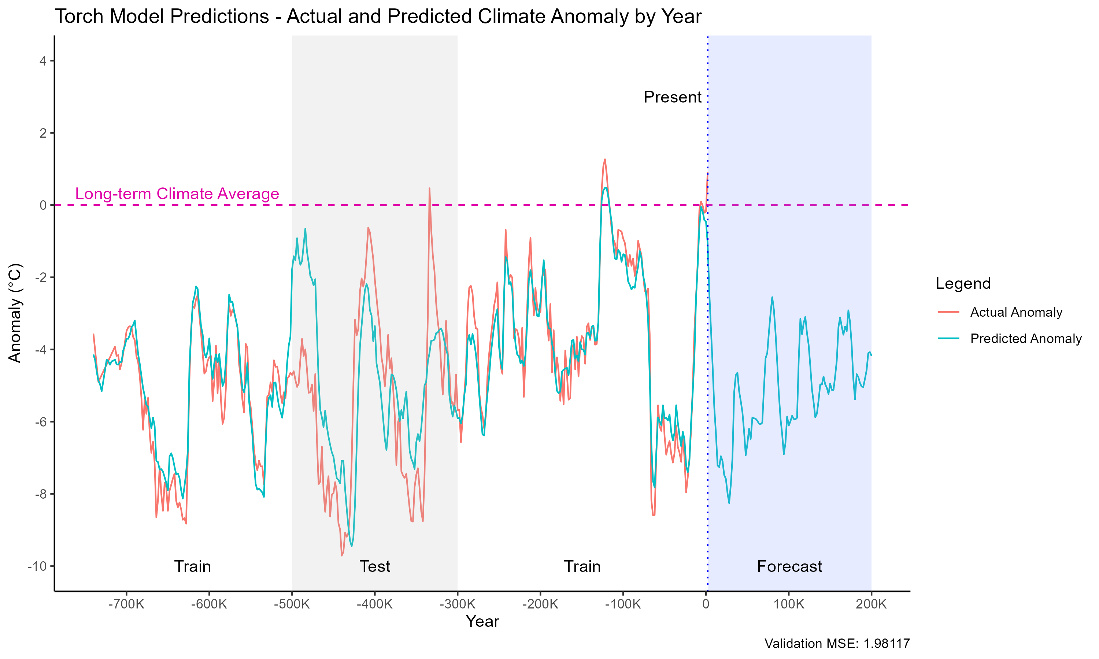
Results
Our neural network model has better performance, with an MSE of 1.98 (improving over 3.56)

Slide 23
Optimization
How do we improve this performance?
Hyper-optimization: Rather than manually setting neural network hyper-parameters (layer size, learning rate, etc.), we can optimize them, finding the hyper-parameters that maximize our performance (minimize MSE)
We used these hyper-parameters:
Layers: [input layer, 64 neurons, 32 neurons, 1 output]
Epochs: 2000 (# iterations of training)
Patience: 10 (interrupt training after this many epochs of failing to improve validation MSE)
Adam LR: 0.001 (controls step sizes during training)
Regularization: 0.05 (penalty for model complexity – adds error based on parameter sizes to discourage relying on inputs that provide only small performance benefits)

Slide 24
Optimization
How do we improve this performance?
Genetic algorithm: Evolutionary computing method in which individuals have genomes that determine their behavior, a fitness function that calculates their performance at some task based on their genome, and mutation and re-combination operators that create new individuals with similar genomes
By granting individuals a chance of surviving and reproducing to create the next generation based on their fitness at a desired task, we slowly obtain genomes that are better for the task
Genetic hyper-optimization: By considering each model as an individual with hyperparameters as its genome and a fitness function based on validation MSE, we evolve models with hyperparameters that minimize MSE

Slide 25
Optimization
Evolution process: 20 neural network models with randomly initialized hyper-parameters – random learning rate, layer configuration, etc.
At each of 20 generations:
Create random “child” individuals, with models that had better validation MSE having a higher chance to produce children
Children produced through random mutation of individual’s genomes, and recombining the genomes of 2 different parents
Train the children on the dataset, using their genome as hyper-parameters
Assign each child’s fitness based on validation MSE
Keep only the 20 individuals with the best fitness
Once all generations are completed, make predictions using the model with the best fitness

Slide 26
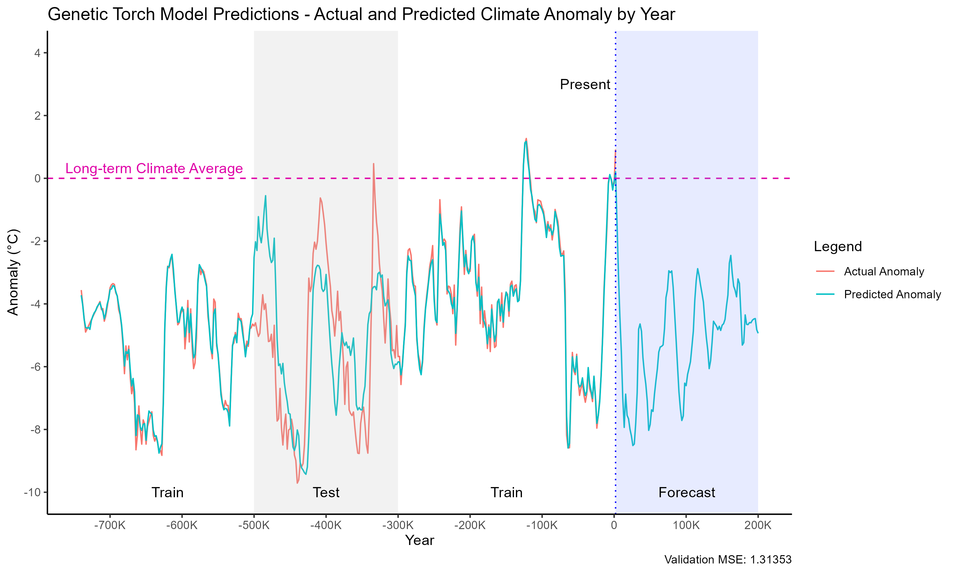

Results
Our genetically hyper-optimized neural network model has the best performance, with an MSE of 1.31 (improving over 1.98)
Predictions very closely match training data

Slide 27
Results
Validation MSE:
Linear Regression: 3.56
Neural Network (manually configured): 1.98
Neural Network (genetically hyper-optimized): 1.31

Slide 28
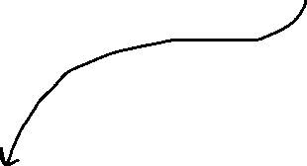
Implications
Approximate forecast accuracy if climate patterns remain consistent
Based on pre-industrial climate patterns, we’d expect a severe ice age to start in the next few thousand years, lasting about 40,000 years, followed by a brief interglacial.

Slide 29
Follow-up Steps
Larger-scale evolution – use more than 20 generations/20 population size
Full process takes about 15 minutes to run
More data
Find a valid way to incorporate solar modulation/CO2 data
Causal analysis
If the causal effect of CO2 can be accurately found and demonstrated to be consistent with pre-industrial and modern data, we could estimate the effect different future CO2 levels

Slide 30
Software used
R (tidyverse, forecast, olsrr): Visualizations, exploratory data analysis, linear regression
Python (SQLite, polars, torch): ETL, data warehouse, pre-processing, neural networks
Power BI: Temperature vs. Year plot (slide 10)

Slide 31
References
Pollen-based climate reconstruction techniques for late Quaternary studies – ScienceDirect
Interglacials, Milankovitch Cycles, Solar Activity, and Carbon Dioxide - Marsh - 2014 - Journal of Climatology (Cairo) - Wiley Online Library
Milankovitch Orbital Data Viewer
CP - Toward generalized Milankovitch theory (GMT)
Repository: GitHub

